Slide 1
NETFLIX
LANDING PAGE

Slide 2
OVERVIEW
This is a copy (clone) landing page of Netflix original.
I have completed this project only using HTML and CSS.
I was inspired on Netflix landing page and re-created like that.
I’m not copied their codes , I just inspired and wrote the codes for what I have seen.
This landing page is about Netflix OTT platform.
It’s full of their features and advantages while using this application.

Slide 3

PROJECT DETAILS
Header section.
Main section.
Footer section.

Slide 4
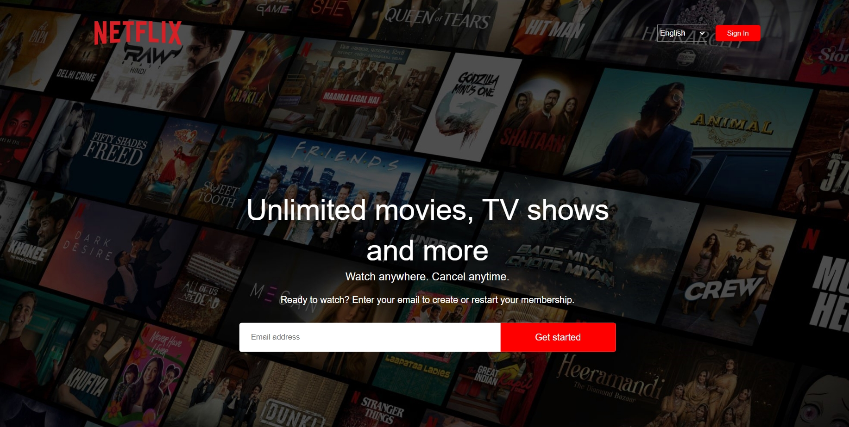
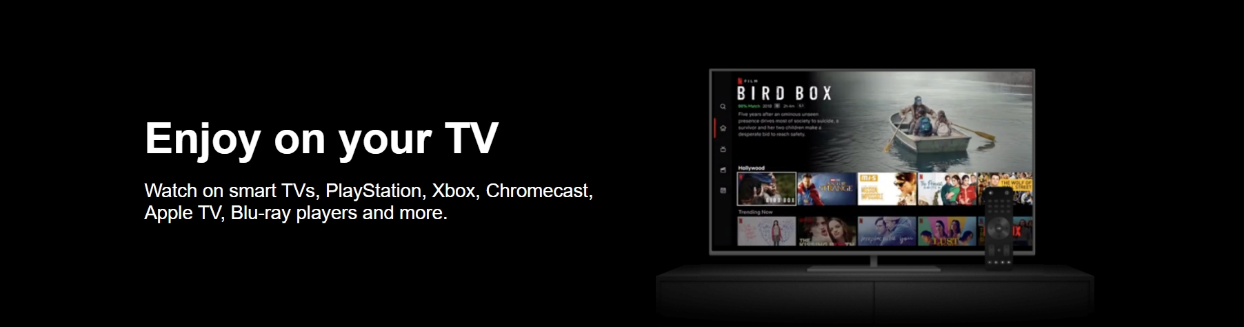
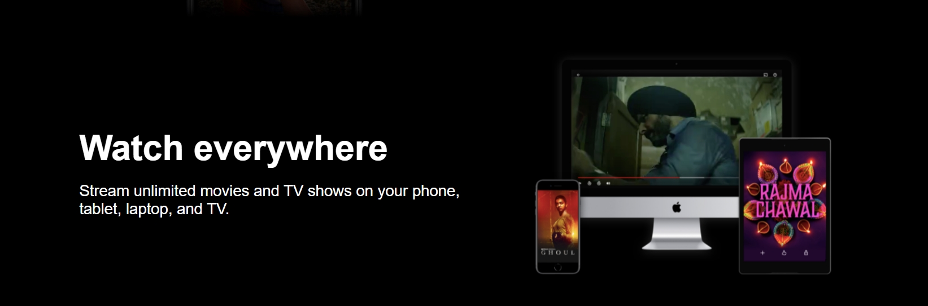
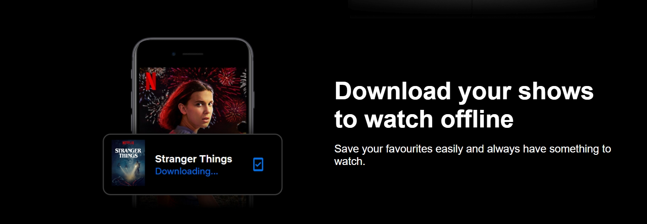
SCREENSHOTS

Slide 5

HEADER

Slide 6
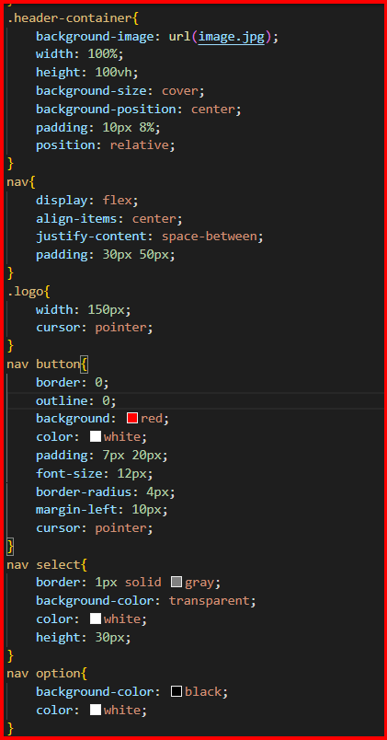
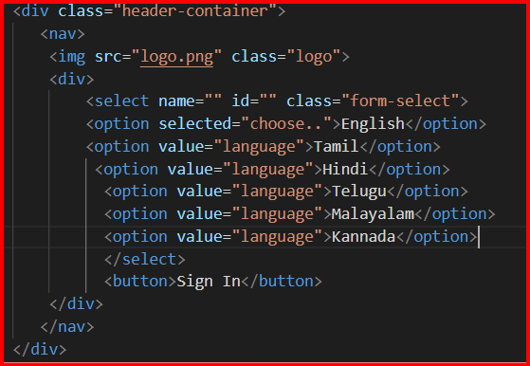

HEADER
HTML

Slide 7
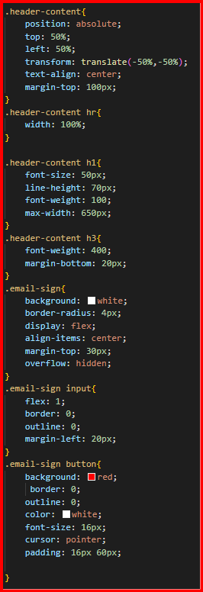
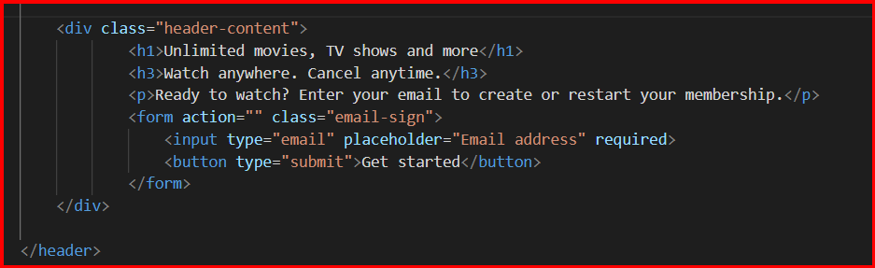
HEADER CONTENT

Slide 8
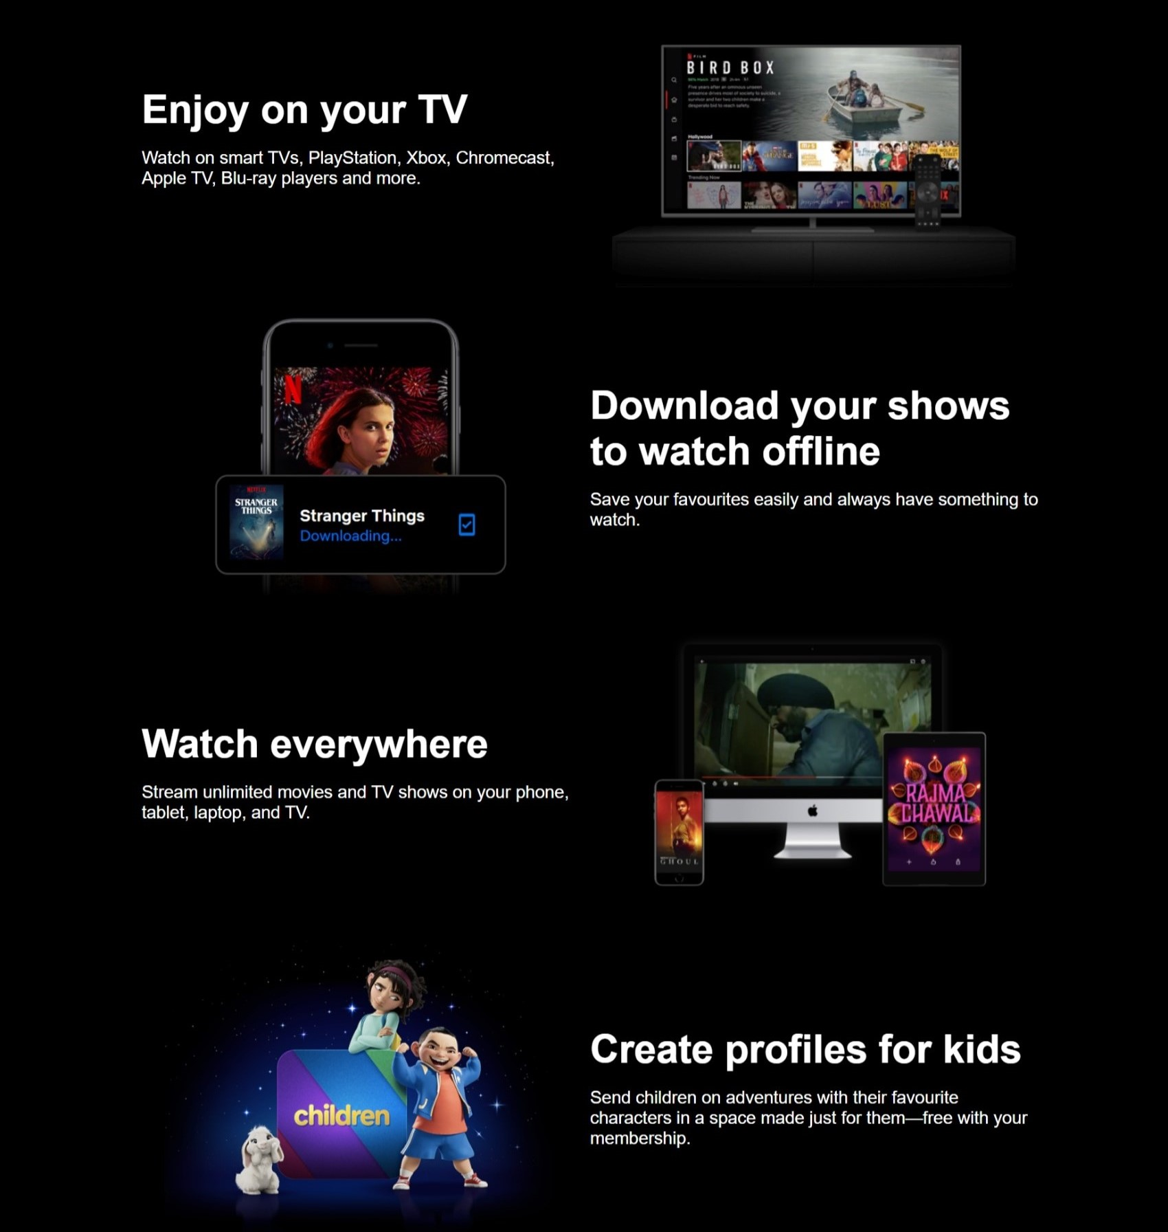
FEATURES

Slide 9
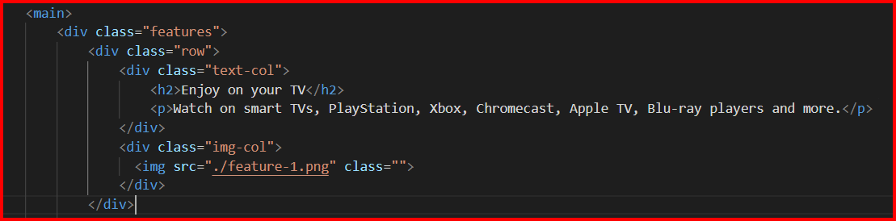
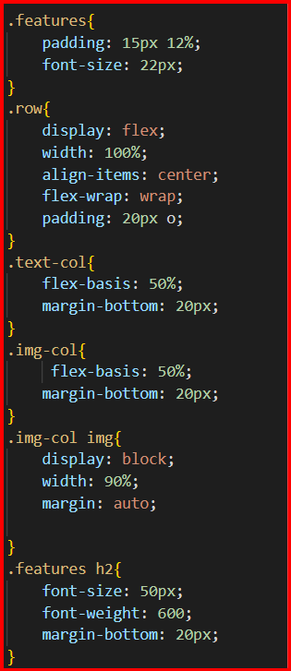
MAIN SECTION

Slide 10
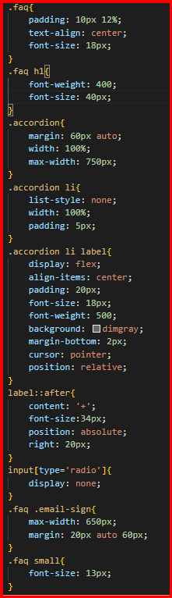
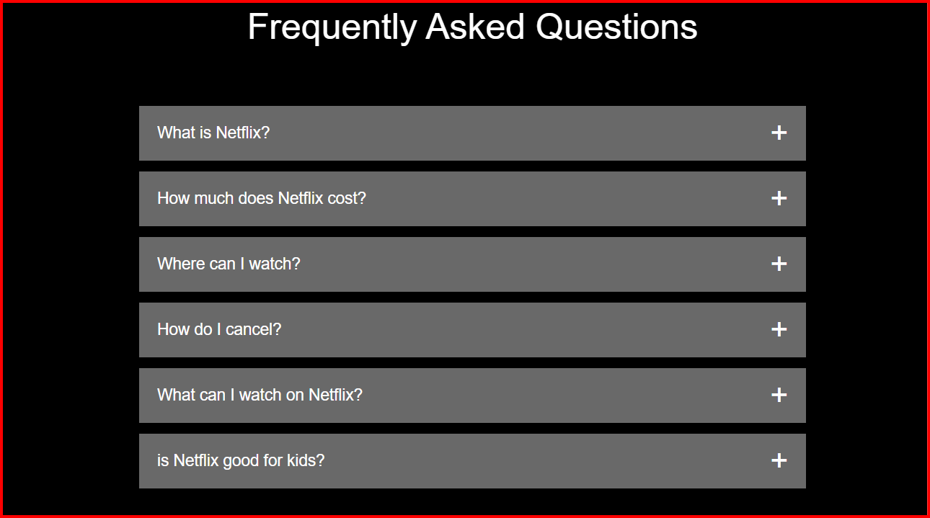
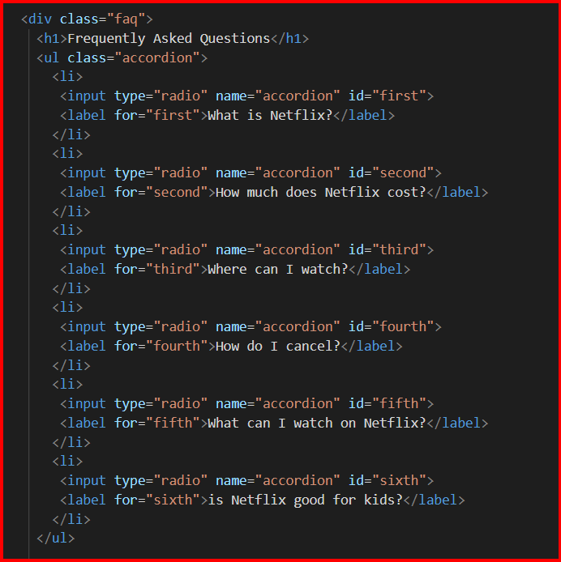
Another div

Slide 11
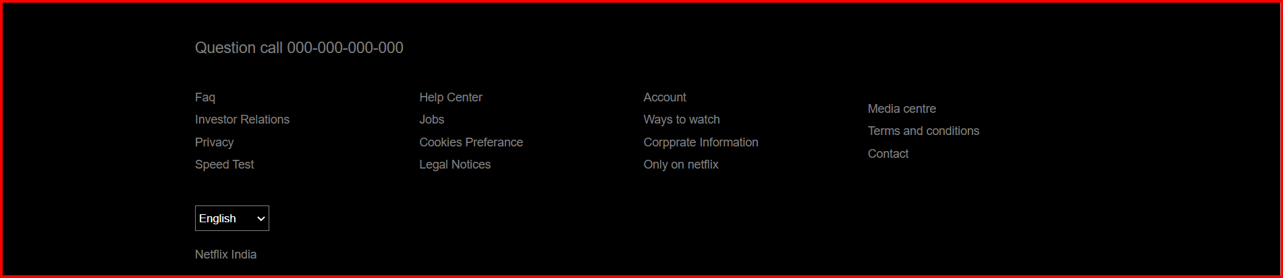
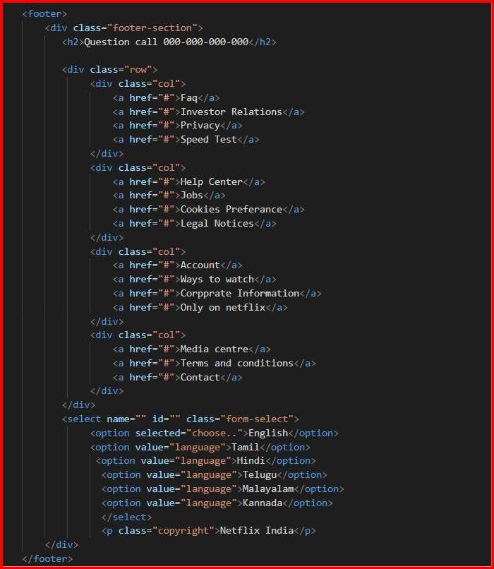
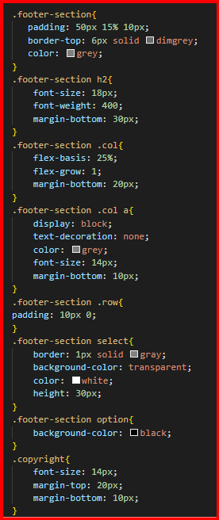
Footer

Slide 12
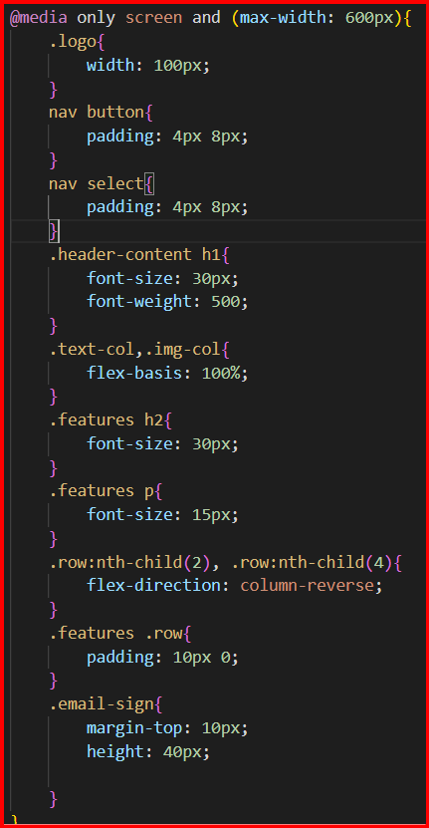
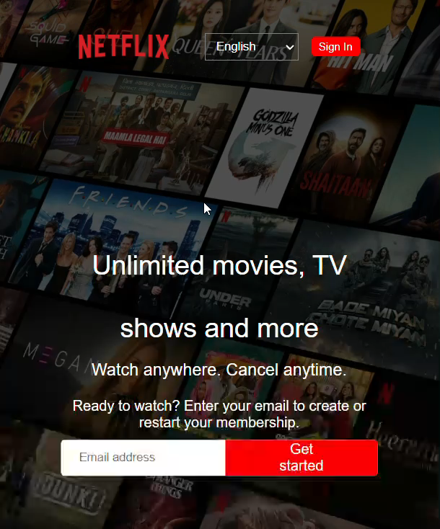
Responsive website

